Slide 1


Child Wellness
Module 17: Project3
Correlation analysis between childhood obesity, poverty and geospatial analysis on fast food restaurants.

Slide 2

Our Team
Zach Blackburn
Kent Roth
Jason Stone
Michael Schell
Celina Espinosa

Slide 3



Introduction
Low-income households can have limited food choices, usually due to economic barriers.
Fast food happens to be affordable, also not so great for you.
We wanted to test how prevalent this issue is in America.

Slide 4
What are we testing?
We gathered child obesity data, health data, poverty data, and fast-food restaurant location data from HealthData.gov, University of Wisconsin, US Census, and TomTom.
This data was used to help us determine whether our hypothesis was correct or not.
We asserted that poverty rate and abundance of fast-food restaurants would have a significant effect on child obesity in an area
How did we test it?
We determined the relationship of these factors and child obesity by running statistical tests and creating geographic visualizations.

Slide 5

WIC Obesity Dataset
Children in families with low incomes are often served by the Special Supplemental Nutrition Program for Women, Infants, and Children (WIC). CDC works with the US Department of Agriculture (USDA) to monitor childhood obesity and identify priority groups and areas that need attention. USDA manages the WIC program at national and regional levels.
*From CDC

Slide 6
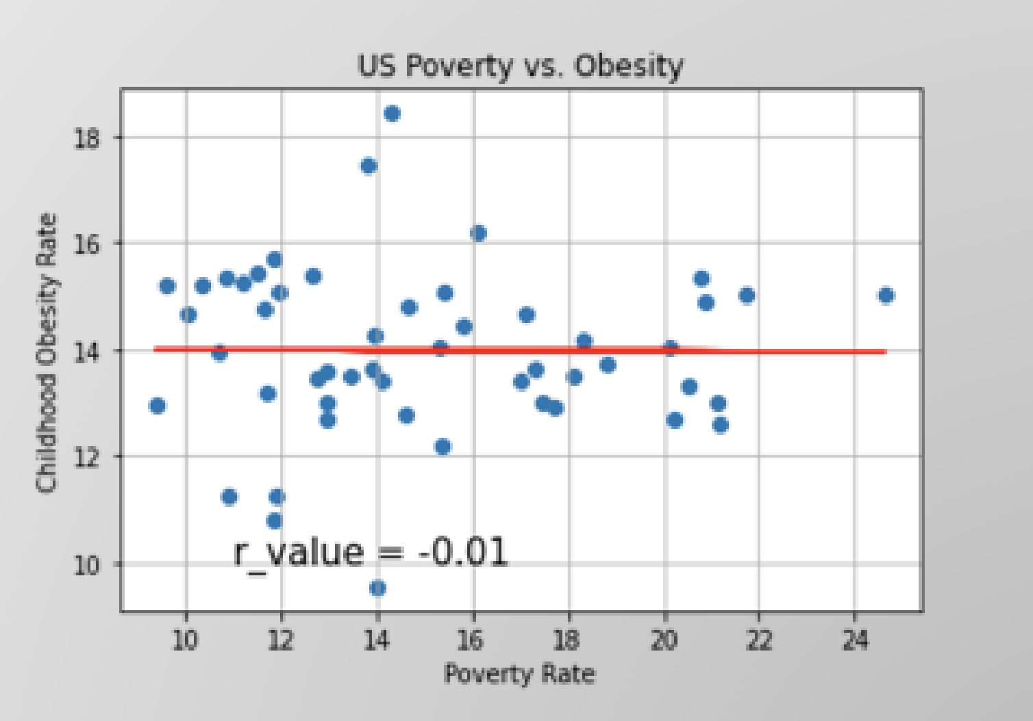
Analysis
Correlation between Poverty and Obesity
The analysis of the relationship between poverty and obesity on the national level, there was no evidence of any correlation, however………

Slide 7
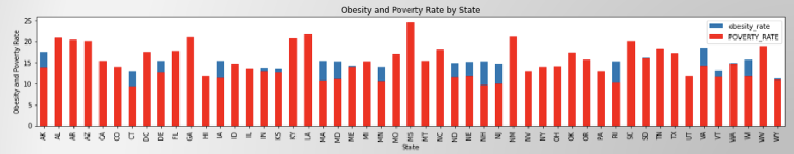
Analysis
Correlation between Poverty and Obesity
…..however, a stacked a stack bar chart of obesity and poverty suggest that there may be a difference in correlations among individual states. This could also be studied on a county level.

Slide 8
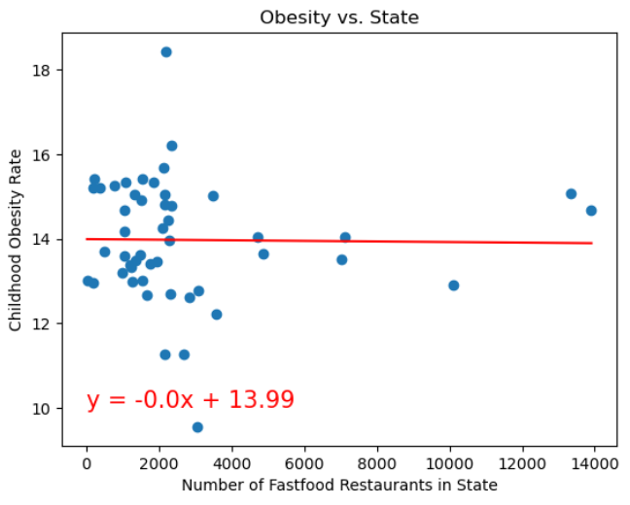
Analysis
Correlation between fast food presence and obesity per state.
By analyzing the collected data, we determined that there is not a strong relationship between child obesity and the presence of fast-food restaurants.. However, it's important to note that correlation does not imply causation, and additional research is often necessary to understand the complex factors contributing to child obesity in specific contexts.

Slide 9
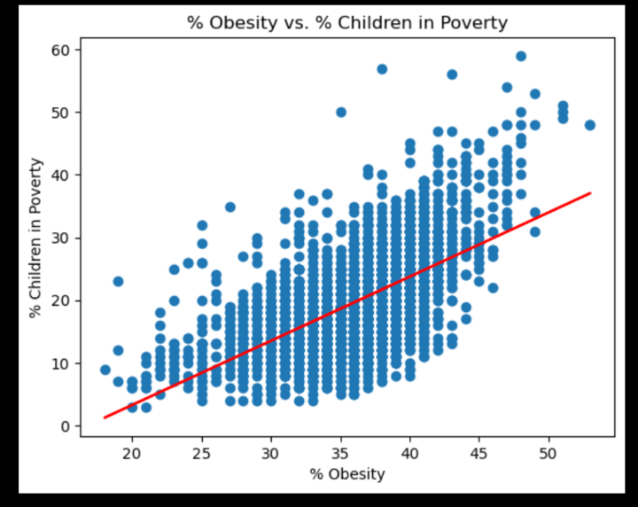
Supplemental Analysis
*From ‘County Health Rankings and Roadmaps” 2023 University of Wisconsin Population Health Institute

Slide 10
Data Mapping Interactive Website
Created map overlays using data from Poverty Analysis, WIC Obesity Analysis, and Fast-food API
Added additional overlay showing ‘Percent Poor or Fair Health’ per county*
Combined with US Census Cartographic Boundary Files
WIC Obesity with US States Geo JSON
Poverty and Health with US Counties Geo JSON
Included the following JS Libraries
D3
Leaflet
J Query (provided additional text formatting options) *From ‘County Health Rankings and Roadmaps” 2023 University of Wisconsin Population Health Institute

Slide 11

Summary
Contrary to our initial expectations, the data analysis revealed that WIC participation rates did not significantly impact poverty values in the examined areas. Additionally, the presence of fast-food restaurants did not exhibit a consistent pattern in relation to either WIC participation rates or property values. These findings indicate that factors beyond WIC participation and property values contribute to the distribution and prevalence of fast-food establishments.
The study's results suggest that other socioeconomic and demographic variables, such as income levels, population density, and cultural factors, likely play a more influential role in shaping the presence and location of fast-food restaurants. It is important to consider these additional factors when examining the complex dynamics between WIC data, property levels, and the prevalence of fast-food establishments.

Slide 12





Resources:

Slide 13

Thank You!!

